Slide 1
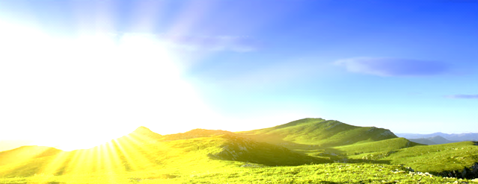

4th International Congress on Energetic and Environmental Systems (IEES)
31 October -02 November, 2025, Djerba-Tunisia
Title of the Research Paper
Manuscript ID_XXX
Authors names, Affiliation
Abstract
Materials and Methods
Conclusions & Discussion
Results
Introduction
Make your graphs big
Enough so
That you’ll really be able to see And read them.
References
Don’t forget to number and title your figures.
Another figure or
Graphic
Figure 1. Title your figures.
Another figure or
Graphic
Another figure or
Graphic
Acknowledgments
Another Figure
Figure 2. Title your figures.

